Slide 1
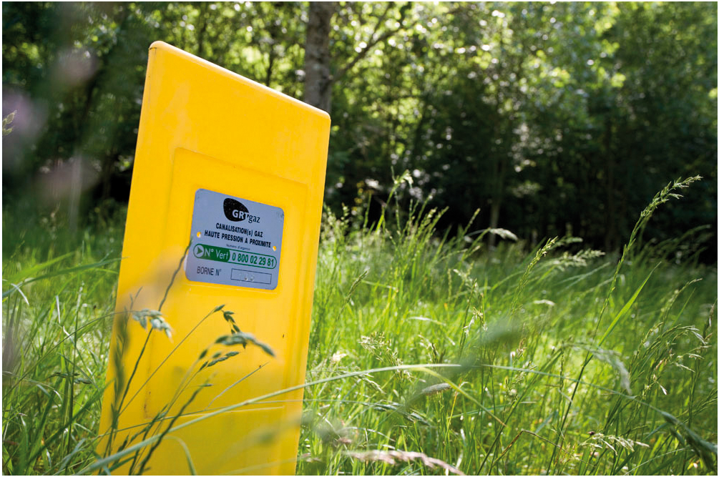
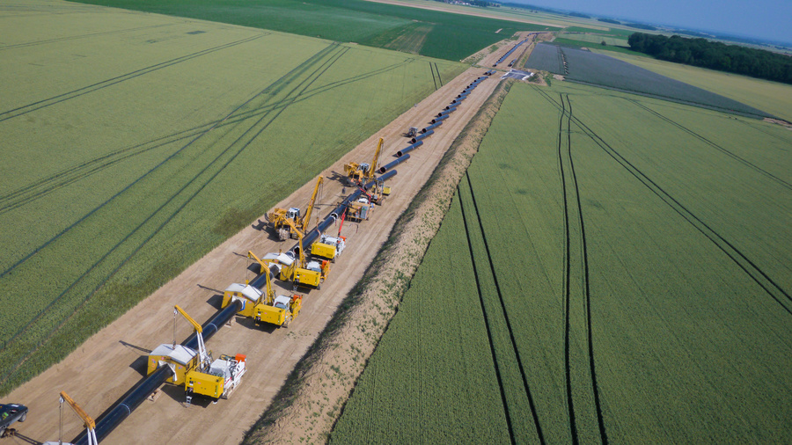
Implementation on PRISMA
25th IG Meeting. South Gas Regional Initiative
13 December 2013

Slide 2
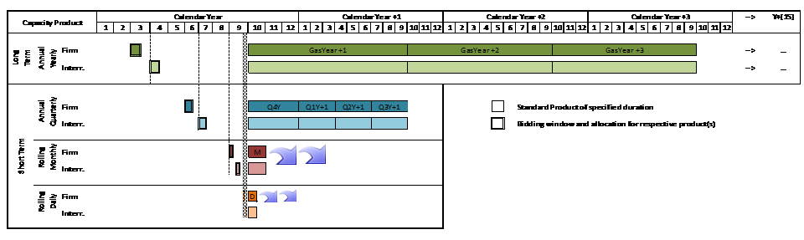
Calendar of Auctions
Calendar as defined in CAM NC

Slide 3
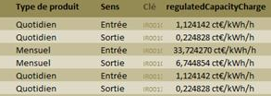
Definition of large and small price steps for each type of product
Reserve Price = Regulated tariff
For Obergailbach (only IP proposing Monthly capacity at this stage)
  Large price step = 5% of Regulated tariff
Small price step : 1/5 du large price step
Obergailbach
Taisnières

Slide 4
Amount of firm capacity to be sold for each type of product
IP | Technical Capacity |  | Capacity offered via PRISMA
 | Entry | Exit | Monthly |  | Daily
 |  |  | Entry | Exit | Entry | Exit
Obergailbach | 620 GWh/d | 125 GWh/d | ≈100 GWh/d | ≈100 GWh/d | ≈80 GWh/d | ≈105 GWh/d
Taisnières | 570* GWh/d | 200 GWh/d |  |  | ≈108 GWh/d | ≈91 GWh/d
Nota: Averaged data from April to October 2013
* 640 GWh/d as of December
Other Products and other IPs are currently under-discussion

Slide 5
Specific issues addressed (1/2)
Interruptible capacity products to be offered (and condition to trigger the offer)
  Interruptible capacities only proposed when all firm capacity is sold
Financial guarantees
  No specific guarantee for PRISMA. GRTgaz keeps the one in our transmission contract which states Max (100 000 € ; 2 Month of capacity)
Contracts: standard and annexes/standard after the auction
  Our transmission contract has been amended and Annex 2 has been updated
Secondary market: when and where trades will take place, public information
  Secondary market on PRISMA will start the 1st of April 2014
  Training session on Primary and secondary market foreseen the 4th of February 2014
Exchange of information between TSOs: procedure, type, coordination
  Physical meetings with our adjacent TSOs (OGE, GRTgaz Deutchland et Fluxys) to coordinate the products proposed on PRISMA

Slide 6
Specific issues addressed (2/2)
Stakeholders information: communication by TSOs
  Several shippers’ meeting have already been made
  Training session on Primary and Secondary market foreseen the 4th of February 2014
  As soon as a new product is proposed, GRTgaz informs the market via en email
  A workshop is foreseen by early 2014 for GRI South
Monitoring by NRAs
  All new products are validated by CRE

Slide 7
Thank you for your attention!
7

